Slide 1

CS4225/CS5425 Big Data Systems for Data Science
Tutorial 4 – Test Practice
Bryan Hooi
School of Computing
National University of Singapore
bhooi@comp.nus.edu.sg

Slide 2
Example True/False Question
True/False: Personalized PageRank will generate the same ranking for any set of web pages.

Slide 3
Example True/False Question
True/False: Personalized PageRank will generate the same ranking for any set of web pages.
Sample answer: False. It depends on the teleport set.

Slide 4
Example True/False Question
True/False: In the Spark runtime, RDD cannot reside in the hard disk.

Slide 5
Example True/False Question
True/False: In the Spark runtime, RDD cannot reside in the hard disk.
Sample answer: False. RDD can also be in the disk if out of memory. (“spill to disk”)

Slide 6
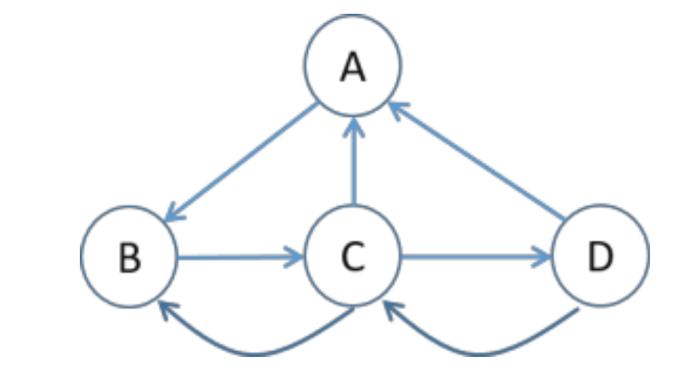
Example Questions
Set up the topic-specific PageRank equations for this graph, with teleport set {A} and β = 0.8 (jump probability = 1−β).
Note: you do not need to solve the equations for r(x).

Slide 7
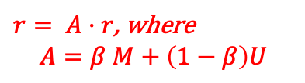
Example Questions
Set up the topic-specific PageRank equations for this graph, with teleport set {A} and β = 0.8 (jump probability = 1−β).
Note: you do not need to solve the equations for r(x).
Sample answer:
$r= A⋅r$, where
$$A=β M+\left(1−β\right)U$$
0 0 ⅓ ½
1 0 ⅓ 0
0 1 0 ½
0 0 ⅓ 0
1 1 1 1
0 0 0 0
0 0 0 0
0 0 0 0
A
B
C
D
Note: For PageRank equations, you can either use the matrix form (like this) or the non-matrix form (individual equations); both are completely fine.

Slide 8
Example Questions
In HDFS, each chunk is replicated for three times by default. In contrast, in Spark, RDD uses lineage for reliability. What are the major problems if Spark also uses replications for reliability?

Slide 9
Example Questions
In HDFS, each chunk is replicated for three times by default. In contrast, in Spark, RDD uses lineage for reliability. What are the major problems if Spark also uses replications for reliability?
Sample answer: Consume a lot of memory.
Note: no need to give additional explanation unless the question specifically asks for it. The questions are designed such that there is a short and simple answer (few words to 1 sentence) which is enough for full marks

Slide 10
Example Questions
Describe a system issue caused by skewed (i.e. highly imbalanced) data distributions on the following systems.
Pregel: computing PageRank on a 1 billion vertex graph, where the degrees of nodes are highly skewed (i.e. some nodes with very large degree)
MapReduce: computing word count, when the frequencies of different keywords is highly skewed (some keywords appearing many times)

Slide 11
Example Questions
Describe a system issue caused by skewed (i.e. highly imbalanced) data distributions on the following systems.
Pregel: computing PageRank on a 1 billion vertex graph, where the degrees of nodes are highly skewed (i.e. some nodes with very large degree)
Sample answer: High memory requirement in some workers OR: high network I/O for some workers
MapReduce: computing word count, when the frequencies of different keywords is highly skewed (some keywords appearing many times)

Slide 12
Example Questions
Describe a system issue caused by skewed (i.e. highly imbalanced) data distributions on the following systems.
Pregel: computing PageRank on a 1 billion vertex graph, where the degrees of nodes are highly skewed (i.e. some nodes with very large degree)
Sample answer: High memory requirement in some workers OR: high network I/O for some workers
MapReduce: computing word count, when the frequencies of different keywords is highly skewed (some keywords appearing many times)
Sample answer: High memory requirement in some workers

Slide 13
Example Questions
Show pseudocode for the compute() function for the PageRank algorithm in Pregel / Giraph. You can (if you choose) use the functions: getValue(), setValue(), getNumVertices(), getSuperStep(), getOutEdgeIterator().
Compute(v, messages):

Slide 14
Example Questions
Show pseudocode for the compute() function for the PageRank algorithm in Pregel / Giraph. You can (if you choose) use the functions: getValue(), setValue(), getNumVertices(), getSuperStep(), getOutEdgeIterator().
Compute(v, messages):
if getSuperStep() >= 1:
sum = 0
for m in messages:
sum += m
v.setValue(0.15 / getNumVertices() + 0.85 * sum)
if getSuperStep() < 30:
sendMsgToAllEdges(v.getValue() / len(getOutEdgeIterator()))
else:
voteToHalt()
Writing pseudo code is fine;
No worries about the syntax. E.g. len(x) or x.size() or “size of x” are all fine.

